Slide 1
Project Gaming Brief
We have been hired to collect data on game sales and analyse the information we found.
The data includes different types data including
Game genres
Platforms the games are produced for
Price of the products
Amount sold
Region of sales
Reviews
This is collected from various sources which only include quantitative data and we have Core and Advanced requirements to achieve.
The company wants to find out which games are rated most popular based on genre and region sold using sales data but also compare that with price and how that impacts the market. Data will be taken from the last 5 years. The aim of the project is to help CFGGaming to analyse the gaming industry and look at what future games would perform well when looking for new titles to produce.
We used MySQL Workbench for this project
Final code is here - https://github.com/pinkpop118/Project-Gaming/blob/main/FINAL%20Gaming%20DB.sql
I worked in a group with 2 other people and presented this to our teachers at Code First Girls for their Kickstarter Data and SQL course.
This presentation is an example of the skills I learned in MySQL, analysing and visualising data.
CFGaming
in partnership with
Danilytics

Slide 2
Requirements to achieve
CORE
ADVANCED
Create relational DB of your choice with minimum 5 tables
Set Primary and Foreign Key constraints to create relations between the tables
Using any type of the joins create a view that combines multiple tables in a logical way
In your database, create a stored function that can be applied to a query in your DB
Prepare an example query with a subquery to demonstrate how to extract data from your DB for analysis
Create DB diagram where all table relations are shown
In your database, create a stored procedure and demonstrate how it runs
In your database, create a trigger and demonstrate how it runs
In your database, create an event and demonstrate how it runs
Create a view that uses at least 3-4 base tables; prepare and demonstrate a query that uses the view to produce a logically arranged result set for analysis.
Prepare an example query with group by and having to demonstrate how to extract data from your DB for analysis

Slide 3
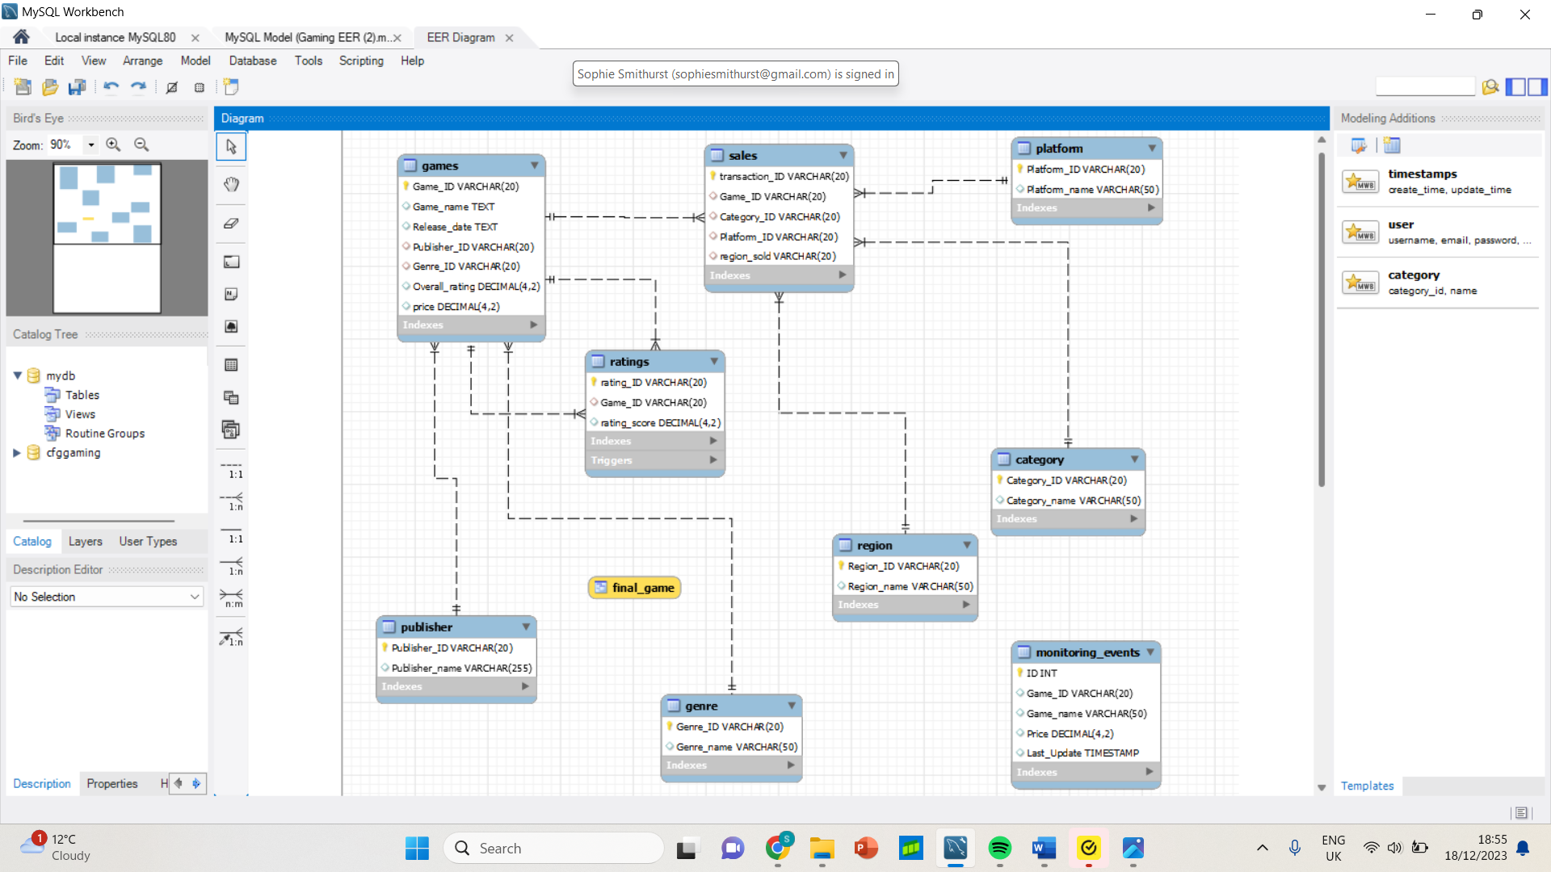
Completing the Core requirements
EER Diagram
First, we created the database then added the data, some manually and some were imported.
We then set PK and FK constraints and altered any data types that imported incorrectly
We then created the EER Diagram
ALTER TABLE Sales
ADD CONSTRAINT FOREIGN KEY (Game_ID) REFERENCES games(Game_ID);
Primary Key
Foreign Key
Data Type
ALTER TABLE ratings
CHANGE rating_score rating_score decimal(4,2);
ALTER TABLE Games
ADD primary key (Game_ID);

Slide 4
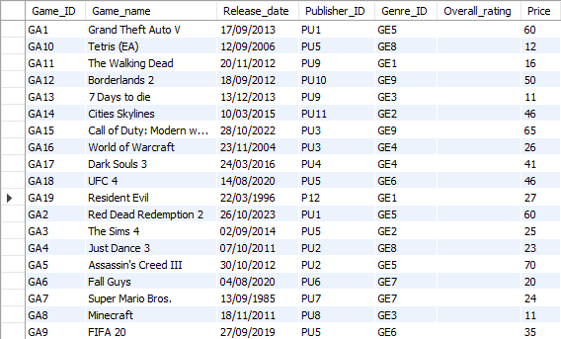
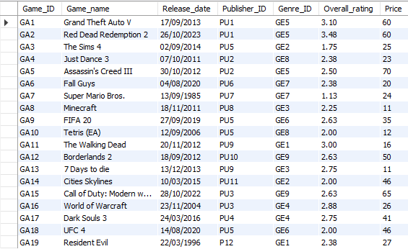
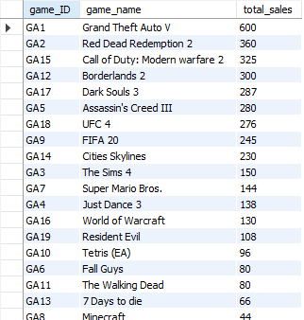
Extra’s
SQL Result Set
At first, we needed to average all the ratings scores from the ratings table and add them to the games table
-- Add average rating for each game
UPDATE game g
SET overall_rating = (select avg(rating_score)
FROM ratings r
WHERE r.game_id = g.game_id);
-- Alter the overall_rating data type
ALTER TABLE gameCHANGE Overall_rating Overall_rating decimal(4,2);
-- Average rating test
SELECT * FROM games;
We then wanted to test the database and do a
simple check on sales
Aggregation and multiplication to see total sales
SELECT g.game_ID, g.game_name,
ROUND(COUNT(s.game_id) * g.price) AS total_sales
FROM sales s, game g
WHERE s.game_id = g.game_id
GROUP BY g.game_ID, g.game_name, g.price
ORDER BY total_sales DESC;

Slide 5
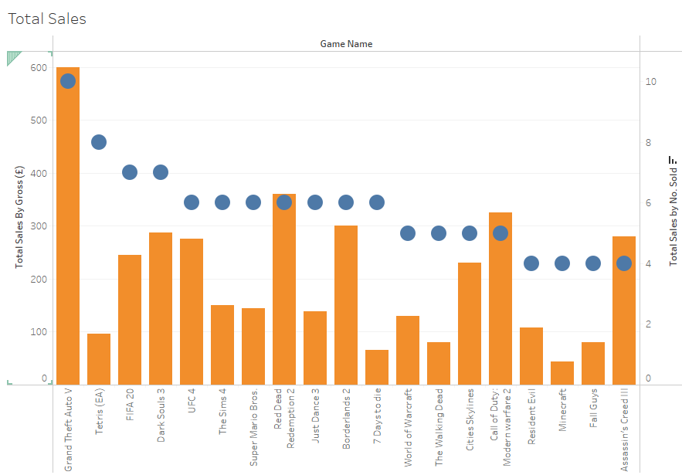

Completing the Core requirements
In Tableau, I used both data sets from gross sales and total units sold. We can see how the price and number of sales correlates using both sets of data together.
Visualisation
We wanted to see the total sale by gross for each game to add to total sales,
so I started with a subquery which gave me basic information.
-- Subquery to see games sales
SELECT count(transaction_ID) AS total_sales, s.game_ID
FROM sales AS s
WHERE game_ID in
(SELECT g.game_ID FROM game AS g WHERE s.game_ID = g.Game_ID)
GROUP BY game_ID
ORDER BY count(transaction_ID) DESC;
Unfortunately, this did not provide me with the game name
I added a join, in order to gain the game name, so this was more informative
-- Subquery to see games sales with a join
SELECT count(transaction_ID) AS total_sales, s.game_id, tab.game_name
FROM SALES as S
inner join
(SELECT g.game_ID, g.game_name FROM game AS g) AS tab
ON s.game_id = tab.game_id
GROUP BY Tab.game_ID, tab.game_name
ORDER BY count(transaction_ID) DESC;
But I found that this can also be done as a normal join
-- Join to see games sales
SELECT count(transaction_ID) AS total_sales, g.game_ID, g.Game_name
FROM sales AS s
INNER JOIN game AS g
WHERE s.game_id = g.game_ID
GROUP BY g.game_id, g.game_name
ORDER BY count(transaction_ID) DESC;

Slide 6
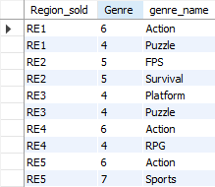
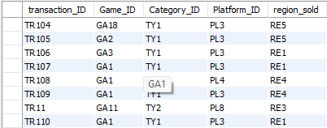
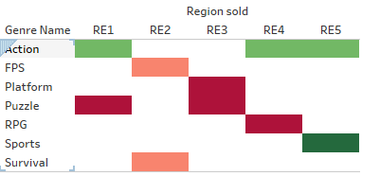
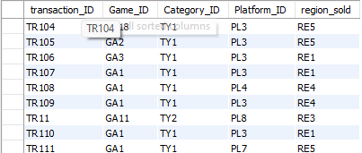
Completing the Advanced requirements
A stored procedure allowed us to input new transactions easily
-- Stored Procedure - Adding a new sales record
DELIMITER //
CREATE PROCEDURE NewTransaction (IN Transaction_ID VARCHAR(20), IN Game_ID VARCHAR(20), Category_ID VARCHAR(20), Platform_ID VARCHAR(20), Region_sold VARCHAR(20))
BEGIN
INSERT INTO sales(Transaction_ID, Game_ID, Category_ID, Platform_ID, Region_sold)
VALUES (Transaction_ID, Game_ID, Category_ID, Platform_ID, Region_sold);
END //
DELIMITER ;
-- Calling the stored procedure to add a new transaction
CALL NewTransaction ('TR111', 'GA1', 'TY1', 'PL7', 'RE5');
We also wanted to look at most popular genre by region using a group by and having clause
-- Group by and Having
SELECT s.Region_sold, count(g.genre_id) AS Genre, ge.genre_name
FROM Sales AS s
LEFT JOIN game g
ON s.game_ID = g.game_id
LEFT JOIN genre ge
ON g.genre_ID = ge.genre_ID
GROUP BY s.Region_sold, genre_name
HAVING Genre > 3
ORDER BY region_sold;
This data shows us the most popular genre types for each region, but it also removes the least popular which reduces the amount of data we look at, as it is not relevant. As we can see, Sports is the most popular and action is next. Sports is most popular in Region 5.
SQL Result Set
Before Procedure
Visualisation
After Procedure

Slide 7
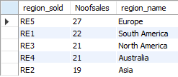
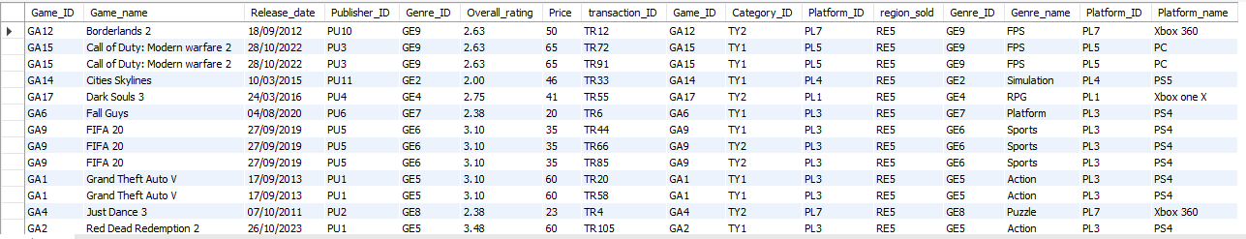
Completing the Core requirements
From this, we can see Region 5, Europe, has the highest number of sales, but we need more information
-- Join to understand more about the highest selling region
SELECT g1.*, s1.*, g.*, p.*
FROM game as g1
LEFT JOIN sales as s1
ON g1.game_ID = s1.game_ID
LEFT JOIN genre g
ON g.genre_ID = g1.Genre_ID
LEFT JOIN Platform p
ON p.platform_ID = s1.platform_ID
WHERE s1.region_sold = 'RE5'
ORDER BY Game_name;
Now we can see more information about the games sold, their genre, price and rating which will be useful to gain more insights
In order to get an idea of where the best place to sell games is, we had to look into sales data for their regions
-- Join - most sales by region
SELECT s.region_sold, COUNT(s.transaction_ID) as Noofsales, r.region_name
from sales s
left join region r
on r.region_ID = s.region_sold
group by region_sold
order by Noofsales DESC;
SQL Result Sets

Slide 8
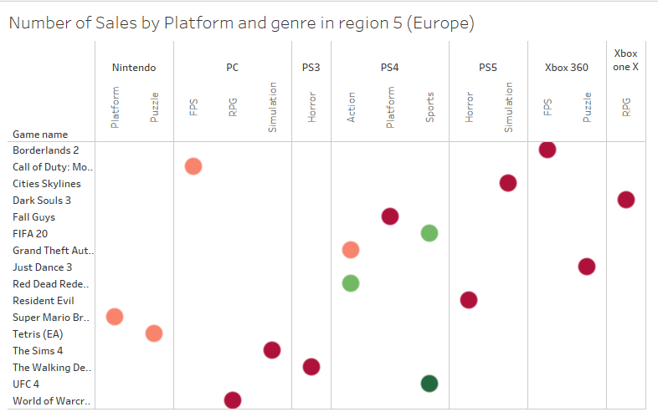
Completing the Core requirements
Visualisation
Once we have visualised the data, we can see that in region 5, the most popular game bought by sales was UFC 4.
UFC 4 is in the genre of Sports and the most popular platform it was bought on was the PS4.
The next most popular games was another sports game, FIFA 20 on the same platform and an action game.
The rest of the data shows a general split between most other genres and platforms

Slide 9
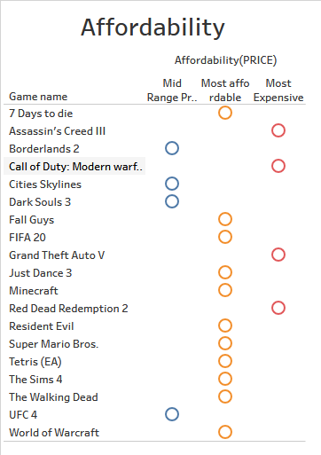
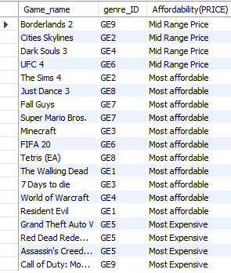
Completing the Core requirements
Visualisation
We wanted to see genres are most expensive, mid-range and most affordable using a stored function. This shows an insight into where games have a benefit or negative aspect which could impact on sales data.
-- Stored Function
DELIMITER //
CREATE FUNCTION Affordability( price INT )
returns varchar(20)
DETERMINISTIC
BEGIN
DECLARE Affordability varchar(20);
IF price > 50 then
SET Affordability = 'Most Expensive';
ELSEIF ( price >= 40 and price <=50) then
SET Affordability = 'Mid Range Price';
ELSEIF price < 40 then
SET Affordability = 'Most affordable';
END IF;
return (Affordability);
END//
DELIMITER ;
-- Function Test
SELETC Game_name, genre_ID, Affordability(PRICE)
FROM game
ORDER BY Affordability(Price);
SQL Result Set

Slide 10
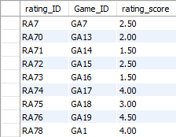
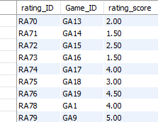
Completing the Advanced requirements
The database before a rating insert and trigger activating
Part of keeping the database up to date, we needed to add a trigger to make sure overall ratings stay accurate when a new rating is added to the ratings table.
-- Trigger - Update overall_rating when a new rating is added
DELIMITER //
CREATE TRIGGER Update_ratings
AFTER INSERT ON ratings
FOR EACH ROW
UPDATE game g
SET overall_rating = (select avg(rating_score) FROM ratings r
WHERE r.game_id = g.game_ID)
WHERE game_ID = NEW.game_ID;
-- Trigger test
INSERT INTO ratings
VALUES
('RA79', 'GA9', 5);
After the trigger activates when a new rating is added

Slide 11
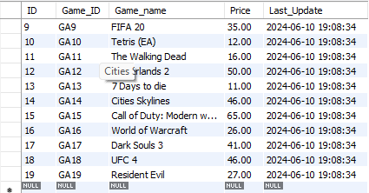
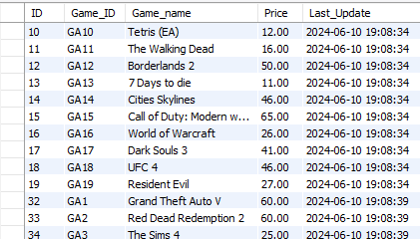
Completing the Advanced requirements
The event will log every game in the game table every 5 seconds (which can be changed). If a new game is added/ removed or a price has changed, it will show this change, which timestamps when the change was made. It may not be necessary for this database but could be more useful in inventory checks.
-- Event
SET GLOBAL event_scheduler = ON;
USE cfggaming;
CREATE TABLE monitoring_events
(ID INT AUTO_INCREMENT, Game_ID varchar(20), Game_name varchar(50), Price decimal(4,2),
Last_Update TIMESTAMP,
PRIMARY KEY (ID));
DELIMITER //
CREATE EVENT check_updates
ON SCHEDULE EVERY 5 second
STARTS NOW()
DO BEGIN
INSERT INTO monitoring_events(Game_ID, Game_name, Price, Last_Update)
SELECT Game_ID, Game_name, Price, CURRENT_TIMESTAMP from game;
END//
DELIMITER ;
-- Event check
select * from monitoring_events;
SQL Result Set

Slide 12
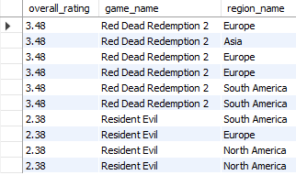
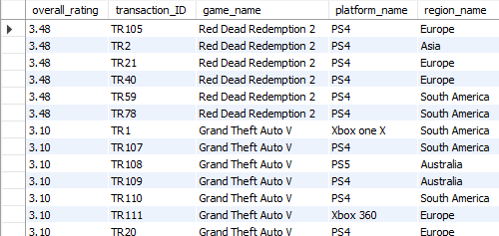
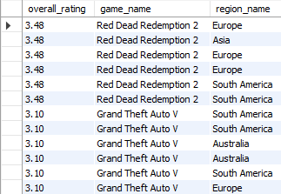
Completing the Advanced requirements
A view is a virtual table which can be used to restrict others access to the database and it can be queried from.
The view can be used as a security measure or make it easy for analysis to be completed from, to reduce the number of complex queries needed to be performed each time.
For example 1 -
SELECT overall_rating, game_name, region_name
FROM final_game
WHERE game_name LIKE 'R%’;
For example 2 -
SELECT overall_rating, game_name, region_name
FROM final_game
WHERE overall_rating > 3 ;
-- View
CREATE OR REPLACE VIEW Final_game AS
SELECT g.overall_rating, s.transaction_ID, g.game_name, p.platform_name, r.region_name
FROM sales s
INNER JOIN game g ON g.game_ID = s.game_ID
INNER JOIN platform p ON p.platform_ID = s.platform_ID
INNER JOIN region r ON r.region_ID = s.Region_sold
ORDER BY g.overall_rating DESC;
-- View check
SELECT * FROM final_game;
SQL Result Sets

Slide 13
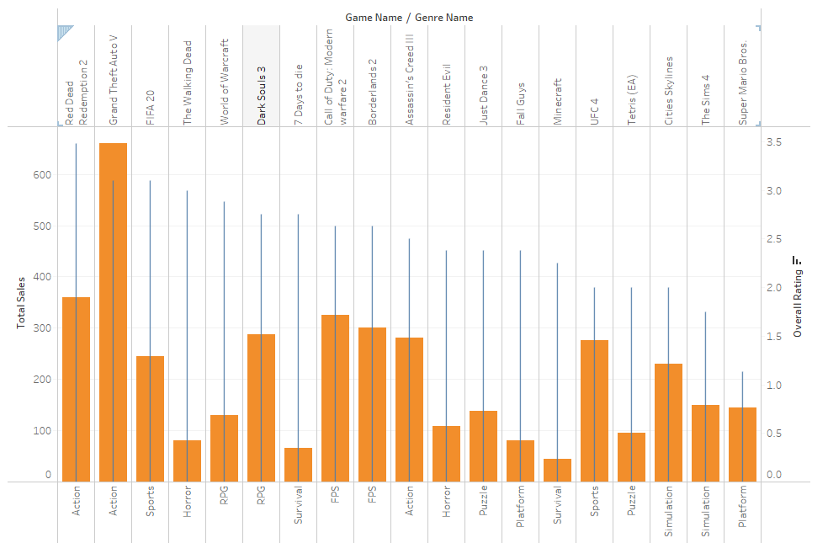
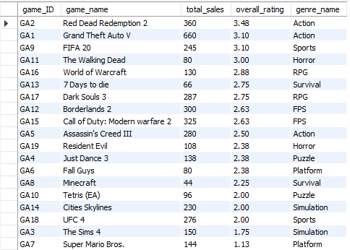
Extra’s
The two topmost rated games are action, followed by a sports game.
GTA V comes out highest on sales and rating.
The data here shows ratings don’t always correlate to sales.
It is also worth comparing sales with ratings of each game and genre to see how this impacts possible opportunities.
SELECT g.game_ID, g.game_name, ROUND(COUNT(s.game_id) * g.price) AS total_sales, overall_rating, ge.genre_namefrom sales s
LEFT JOIN game g
ON s.game_id = g.game_id
LEFT JOIN genre ge
ON ge.genre_id = g.genre_id
GROUP BY g.game_ID, g.game_name, g.price, overall_rating, genre_name
ORDER BY overall_rating DESC;
SQL Result Sets

Slide 14
Outcomes
So, to answer the questions, we want to confirm which games are rated most popular based on genre and region sold
The most popular games are Sports in Region 5 (Europe) so this would be a good region to release a sports game in for future.
From the analysis, we can see that GTA 5 has the most sales, even though it is not the most popular genre, it has brought in the most money.
An interesting find is that the most expensive 4 games bring in the most money even though the genres are not the most popular in region 5.
Releasing a game on PS4 would be most beneficial as Xbox and PS5 sales were not as profitable in Region 5
It is best to avoid platform/puzzle games in Region 3 as these seem a lot less popular.
Action based games are also generally and overall favourite, even with a higher price tag. This could be due to the long-standing series in this area of games as we can see that one off games with no follow-on titles bring in as much less money like Tetris, Minecraft.
Keeping track of ratings and sales for each game is important to monitor the changes in customer preferences.

